Slide 1

Finalists Pitching Session 2
4 May, 09:00 AM EDT // 15:00 CEST

Slide 2
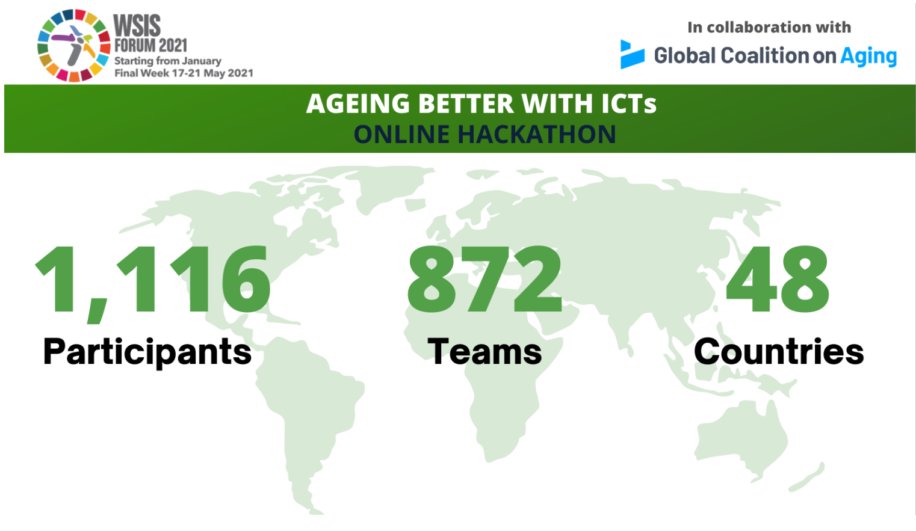

Slide 3
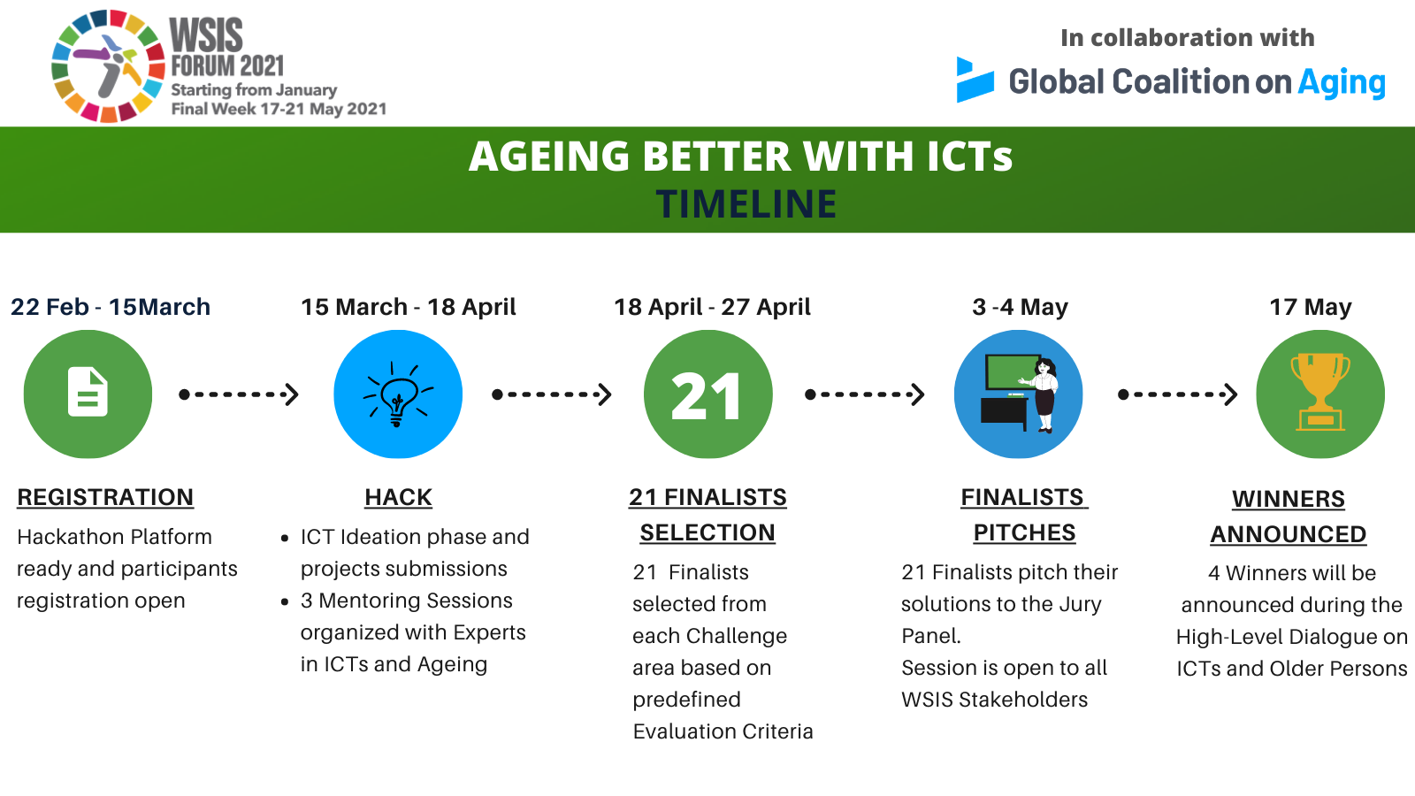


Slide 4

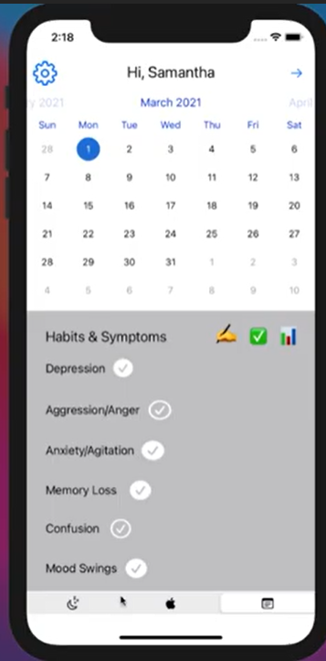
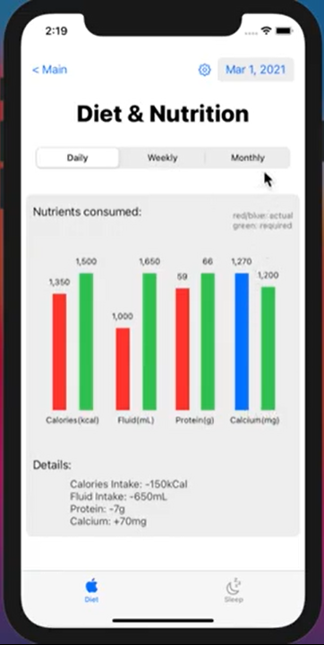
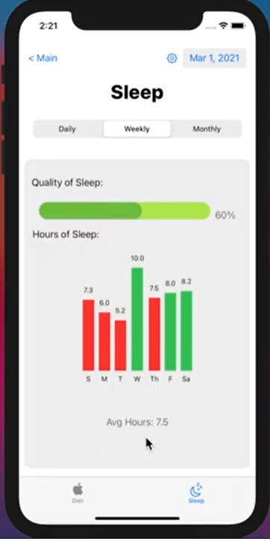
Project : CareBuddy - an App for Caregivers
1
CANADA
TEAM Name
Team_127
Team Age Group
20
CHALLENGE AREA
Alzheimer’s Disease and Cognitive Decline
iOS Calendar/progress tracking application including:
Sync with Google/Apple Calendar
Sync with Apple Health Tracker/FitBit
Share accounts between multiple caregivers/family members
Daily/Weekly/Monthly statistics for categories including sleep/diet of patient
Record specific patient habits/symptoms and add notes
Adding picture/video as a memory, which is later presented as a slideshow

Slide 5

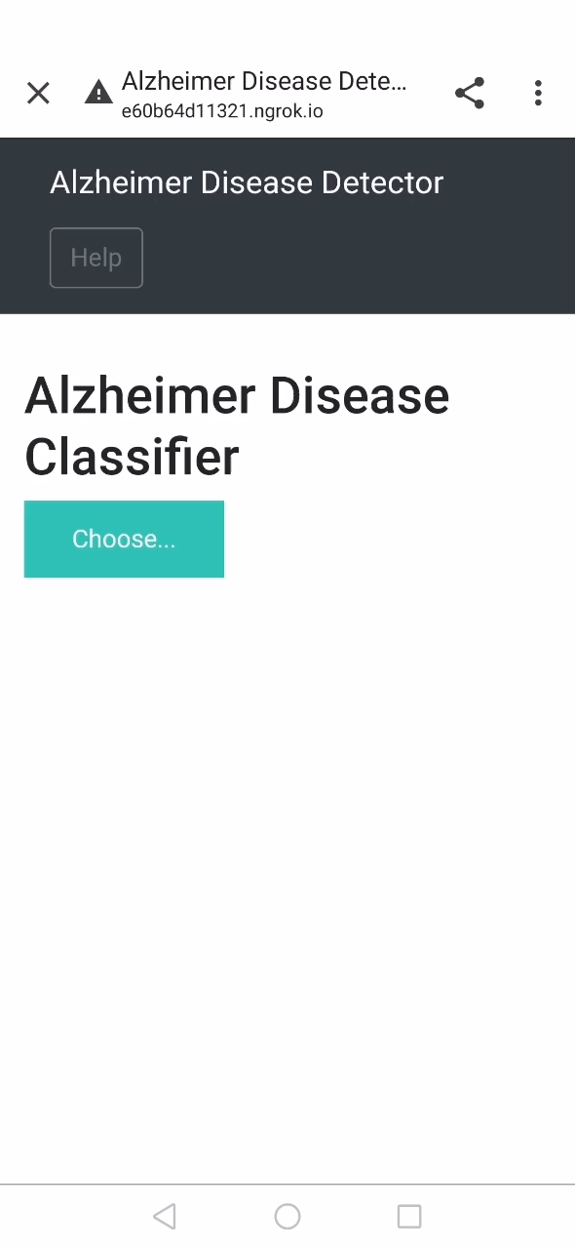
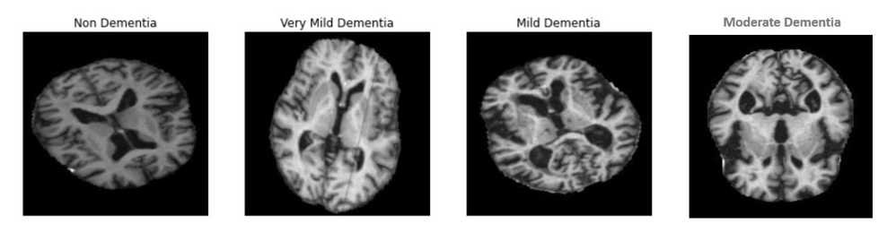
Project : Alzheimer Disease (Dementia) Detector using
Deep Learning model
2
INDIA
TEAM Name
BLINK
Team Age Group
21-23
CHALLENGE AREA
Alzheimer’s Disease and Cognitive Decline
The team worked on developing an automated system that would aid the pathologists in identifying signs of dementia in MRI scans.
The proposed system is a Deep learning model capable of differentiating demented and non-demented brain scans. The model can classify four classes of scans: Non-Demented, Very Mild Demented, Mild Demented , Moderate Demented. The deep learning model used for this project is DenseNet169 which gave an accuracy of 88% and is deployed as a web app using Flask-ngrok package available in python libraries. This application can be scaled to identify the regions in the brain affected due to dementia and be deployed as a mobile application.

Slide 6
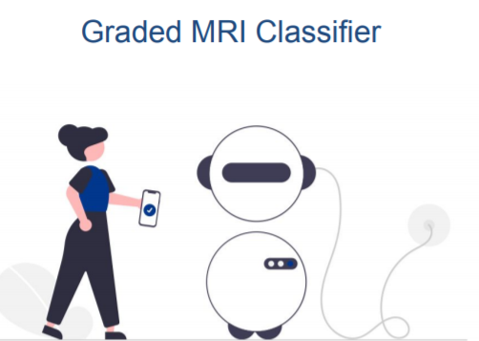
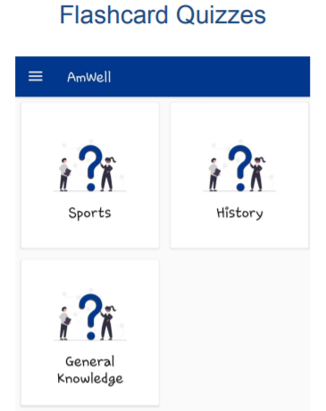
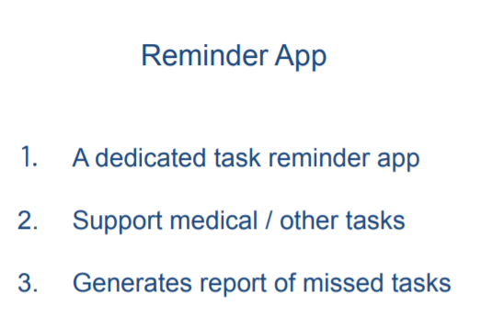
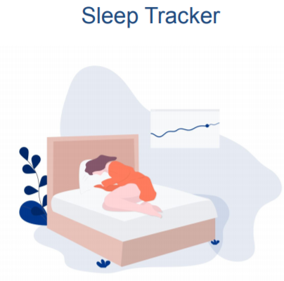
Project : AmWell
3
INDIA
TEAM Name
Chronology.AI
Team Age Group
21
CHALLENGE AREA
Alzheimer’s Disease and Cognitive Decline
The team built an app that aids the elderly to:
• Graded MRI Classifier: AI powered classifier for instant graded dementia report generation
• Flashcards Quizzes: Interactive quizzes from general knowledge and sports to history
• Sleep Tracker: Track &amp; Monitor your sleep, get personalized periodic reports
• Reminder App: Set tasks, get reminders, enjoy!
• Fall Detector: Alert when the host falls
• Connect to doctor: Peer to peer connection with doctors
• Community: community builder

Slide 7
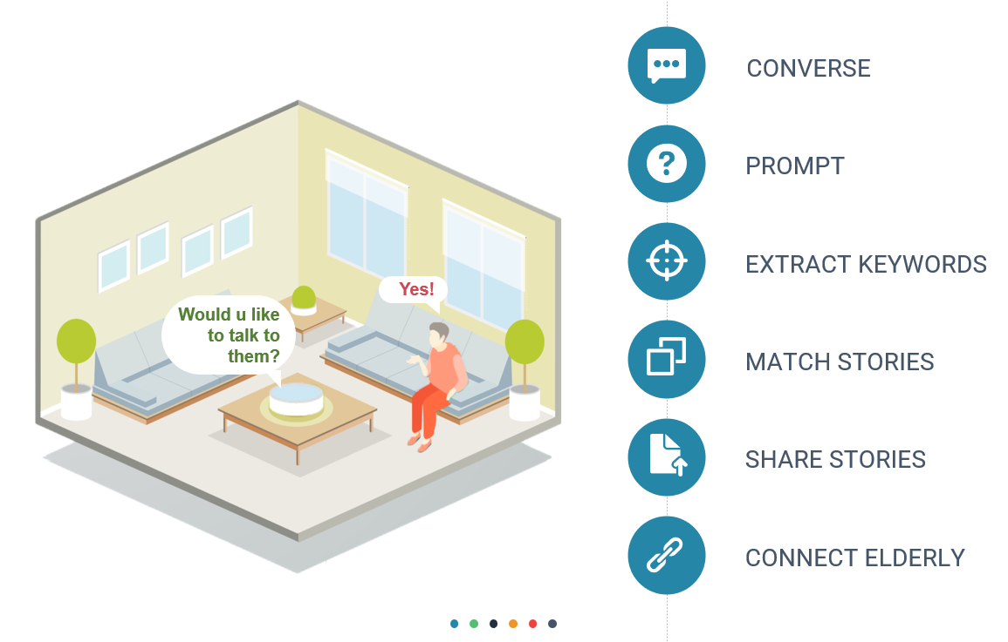
Project : Sync Up
4
INDIA
TEAM Name
Sync Up
Team Age Group
21
CHALLENGE AREA
Alzheimer’s Disease and Cognitive Decline
The Platform Sync Up developed by the team will provide a Social Media Platform to the elders.
The device will be using stories to collect information which will play a key role in detecting diseases and other major health issues along with using the stories to group similar type of people facing similar day-to-day activities hence reducing loneliness, which is a major cause for depression, heart diseases, Alzheimer's, etc.
The platform will also act like an elderly care system which will keep track of their location, medicine routine, mental state and then inform their families and concerned persons in case of emergency.

Slide 8
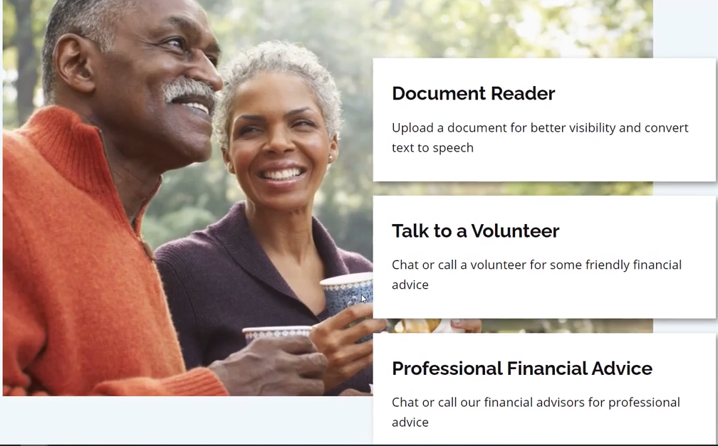
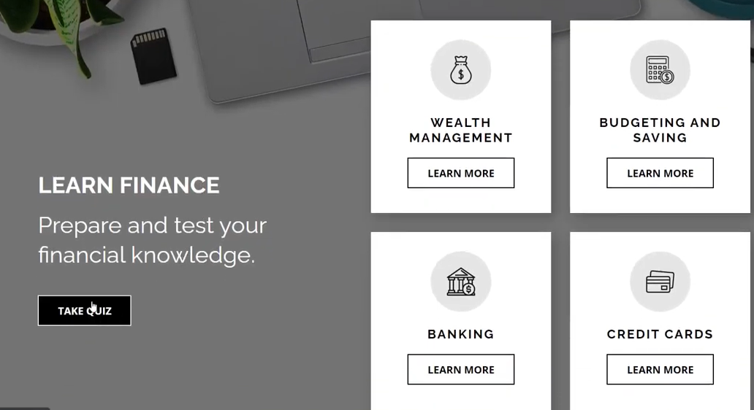
Project : Limitless
5
INDIA
TEAM Name
Pizza_hungry
Team Age Group
20-22
CHALLENGE AREA
Financial Tools for Longevity
While there are many resources available on the internet, there is a lack of those that provide a self-help service for the elderly to manage their finances and seek help for them.
The solution the team developed provides a comprehensive self-help website with tools like the document reader that allow you to upload a document and print it more legibly, word for word. This improves accessibility and ensures data protection and security.
The solution also offers the user the chance to :
chat with volunteers trained in relevant topics for valuable insight and advice, or to just have a friendly conversation and even form groups.
use a paid service to speak to professional financial advisers remotely if more in-depth advice is required.

Slide 9
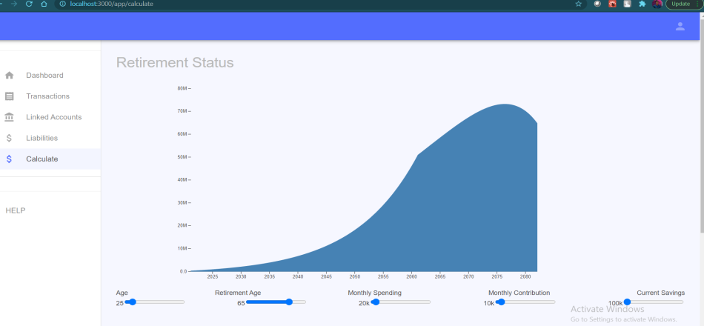
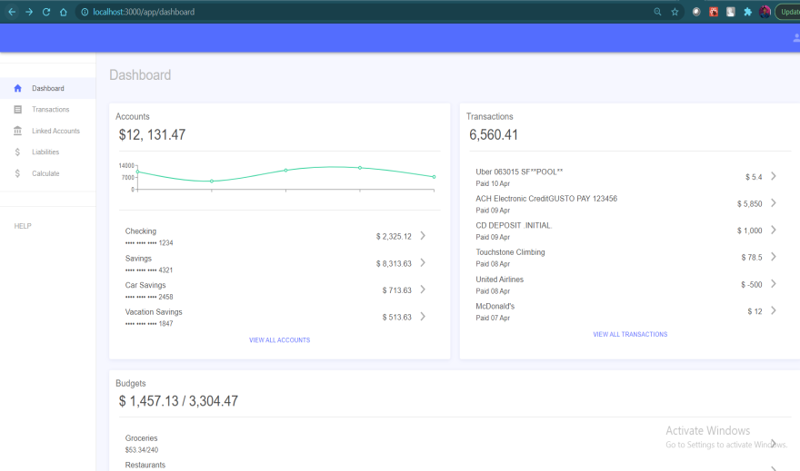
Project : Retirement - Fintech
6
INDIA
TEAM Name
Pied Piper
Team Age Group
22
CHALLENGE AREA
Financial Tools for Longevity
The solution proposed by the team is to use technology (web, data analytics, etc.) and to create an application that takes into consideration user’s current financial status such as assets, liabilities, investments, etc., and global factors (inflation, location specific lifestyle, stock markets, etc.) to model user’s future retirements needs and what, when, and how current savings can lead to future retirement corpus. Data points are collected through API’s and modelled to create an output and displayed in chart for easy understanding.

Slide 10
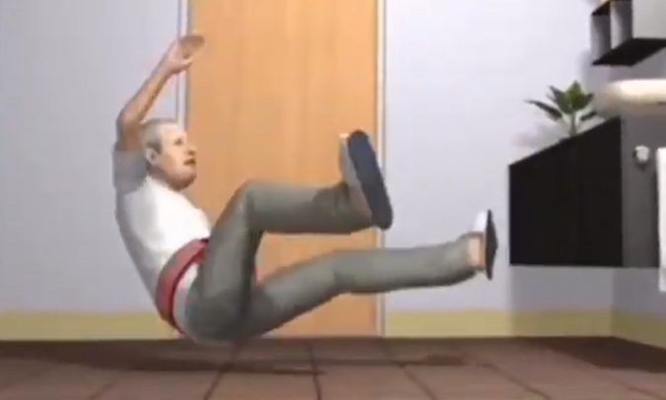

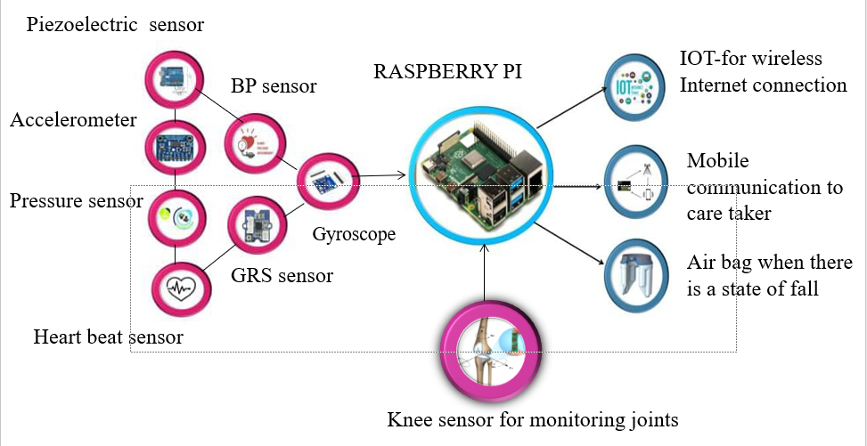
Project : Ageing Better with ICTs
7
INDIA
TEAM Name
p762_7212
Team Age Group
19-20
CHALLENGE AREA
Frailty
The team developed a solution that uses sensors to monitor the human body regularly, including knee sensors which will monitor the joints and state of bones. The elderly fall is mainly dependent upon the posture of the human body.
The solution enables :
Detection of the future fall through Raspberry Pi and a phone call is sent to the caretaker,
An airbag which is worn by the elder in their hip gets automatically released to prevent the risk of injuries.

Slide 11
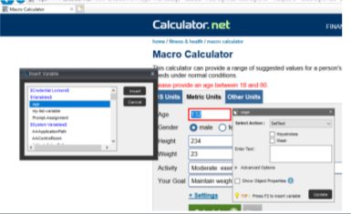
Project : An Autonomous Diet Recommendation/
Shopping Bot
8
INDIA
TEAM Name
prithvivasireddy_cb04
Team Age Group
21-23
CHALLENGE AREA
Transportation and Mobility
The team has developed a combined bot for autonomous diet recondition and shopping using automation anywhere, which can create a recommender system that can act as a meal planner.
The bot can further breakdown these recommendations and do the (automated) shopping for you by integrating/collaborating with a web/mobile-based delivery application (or) a local store. The proposed solution can send a large number of diet recommendations to hundreds of users in a database at a very expeditious rate.
The bot recommends a healthy diet based on lifestyle (also considers lifestyle diseases) and does the shopping for you. Unlike the applications currently in the market, this bot is powered by reinforcement learning (AI) on the back-end to intuitively adapt to the customer/user progress.

Slide 12

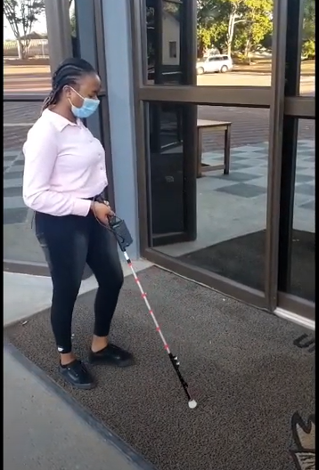
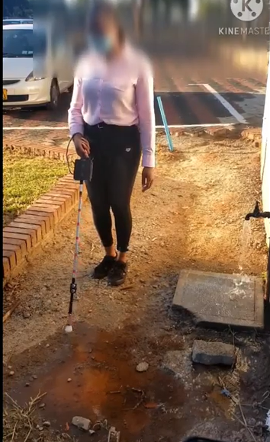
Project : Smart Walking Stick
9
ZIMBABWE
TEAM Name
Tafadzwa Muusha
Team Age Group
24-25
CHALLENGE AREA
Transportation and Mobility
The Smart walking stick acts as an artificial vision tool for elderly people suffering from vision loss. It detects obstacles and water bodies in front of them, and it alerts the user through vibrating and emitting notification sounds. Notification sound for obstacle detection is different from notification sound for water detection, this enables the user to differentiate between an obstacle and water.
It comes with a remote attached to a neck tag, that the elderly user should wear at all times, in the event that they misplace the walking stick they simply press a remote button that triggers the stick to beep until they locate it. The remote is also used for powering the walking stick.
The walking stick has a battery life of up to 24 hours of continued use, and is rechargeable. The walking stick carries a GPS tracking system that helps track the walking stick if it has been misplaced or stolen. It also comes with a mobile application that is used by a close relative of the visually impaired elderly user to keep track of the user’s activity and location. The walking stick also provides support to the user when walking.

Slide 13
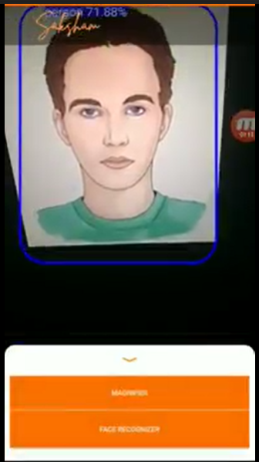
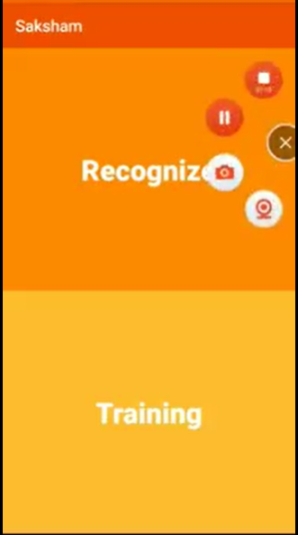
Project : Saksham
10
INDIA
TEAM Name
Insignia
Team Age Group
31
CHALLENGE AREA
Transportation and Mobility
The team developed an app called Saksham which translated to ‘Capable’ in English. The objective of this app is to help old people with low visibility to identify different objects and recognize their loved and dear ones. The app will have a voice engine to help people know what they are seeing. Also, the facial recognition features will have an added protection feature as it will help them identify the right person to visit their premises. Also, this app can be scaled up to a Google glass kind of device which the person can wear use the features.
Included Features:
Object detection: Detect different objects the person is viewing
Voice interface: If the user clicks on the identified object the voice engine will speak the name of the object.
Magnifier: A built-in magnifier lens helps to view things clearly
Facial recognition: Train the model with pictures of your near ones and the app will help you identify if the person meeting you is your near one or a stranger.

Slide 14

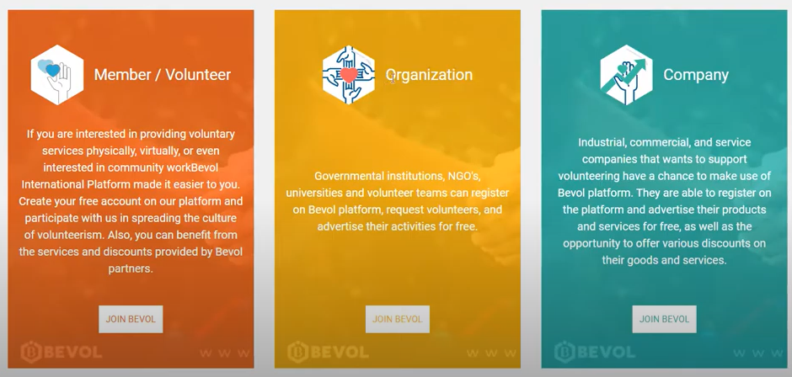
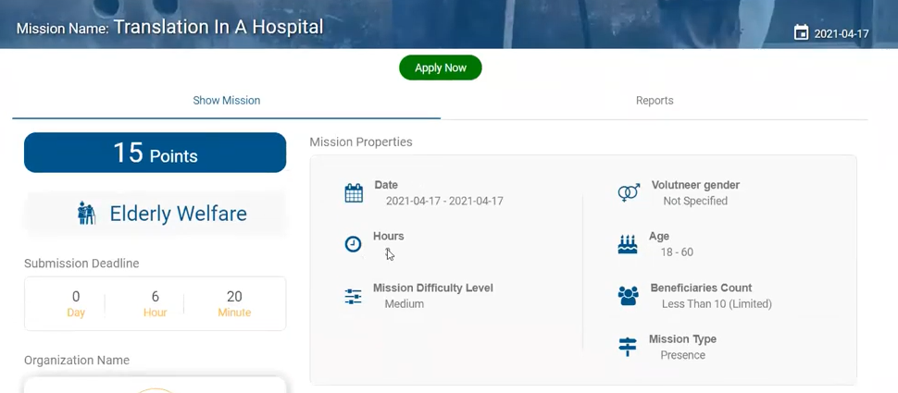
Project : BEVOL Club For Elderly Care
11
Syrian Arab Republic
TEAM Name
Bevol Team
Team Age Group
21-32
CHALLENGE AREA
Financial Tools for Longevity
Bevol is the first social media platform in the world specialized in the field of volunteering and social service.
Bevol works to organize and network volunteering work and to enhance the performance of social responsibility within an interactive and motivating environment in order to offer a new vision of volunteering.
Bevol provides its members with volunteering opportunities in various fields, as well as providing them with training programs that contribute to developing their skills and building their expertise in the fields they are interested in. That is why Bevol seeks to establish volunteer clubs specialized in specific fields.

